Slide 1
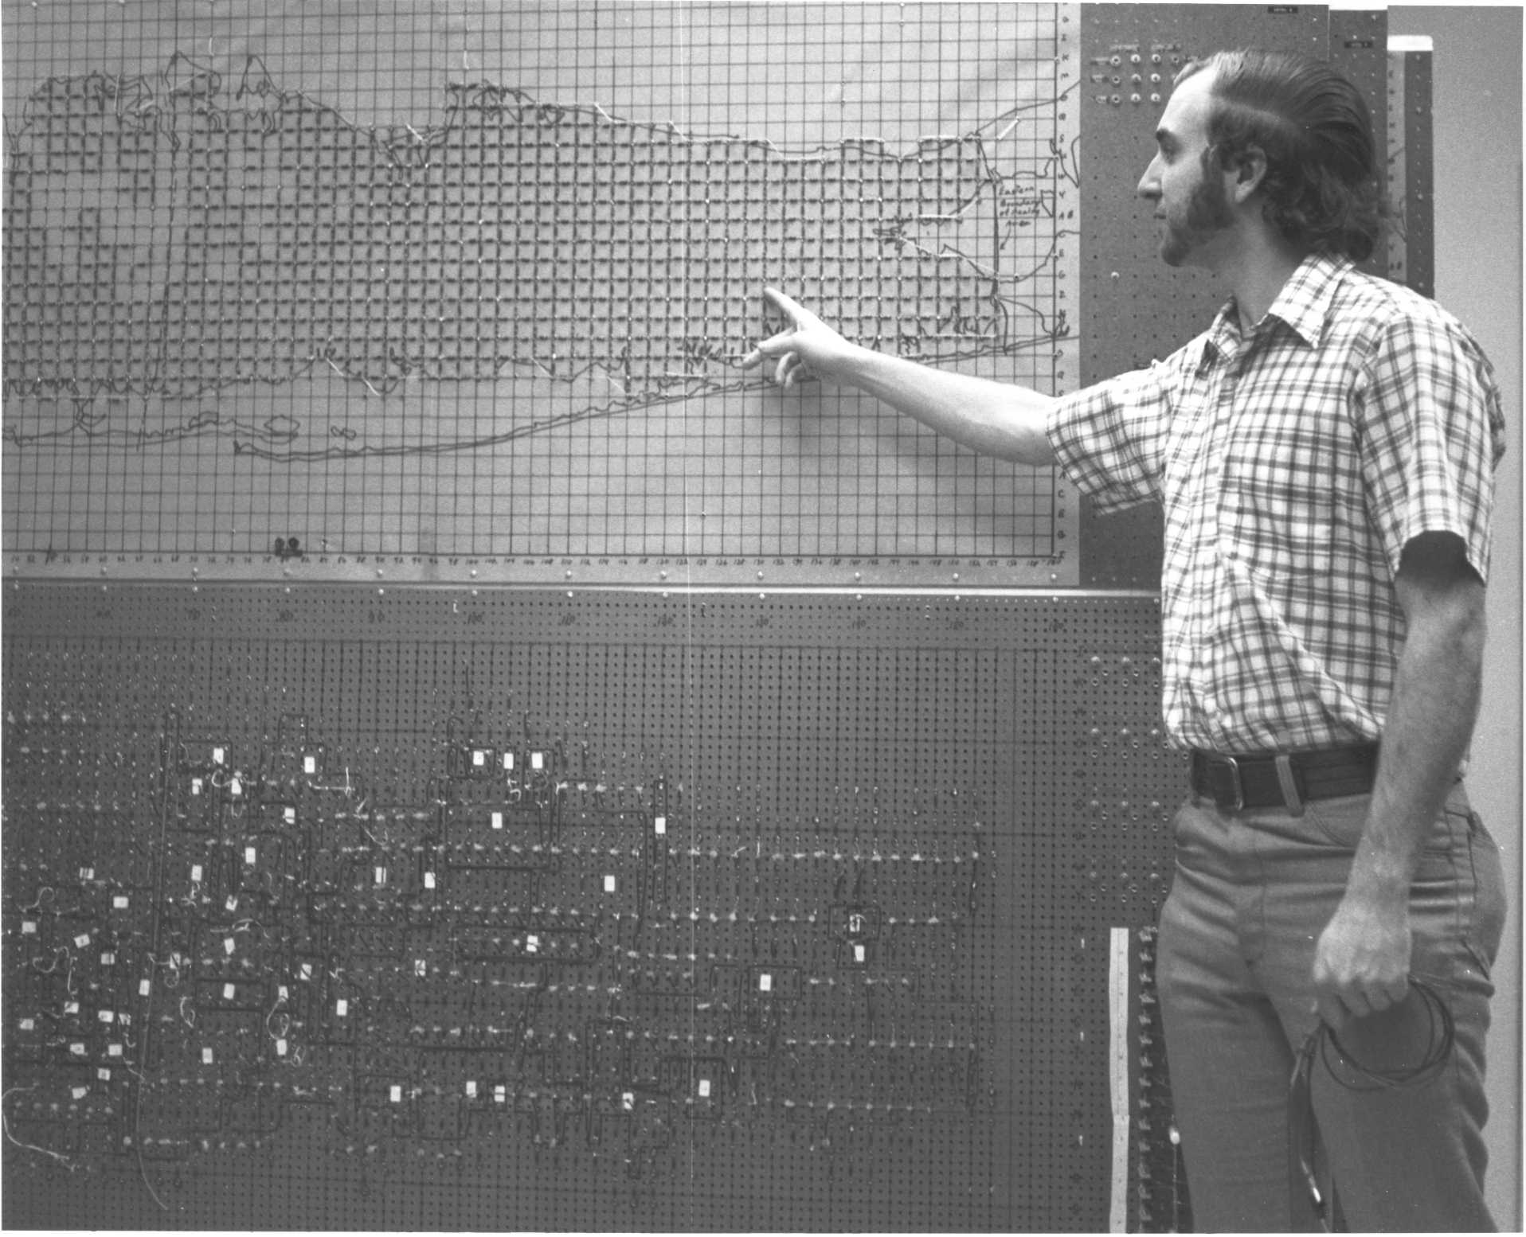
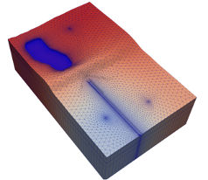
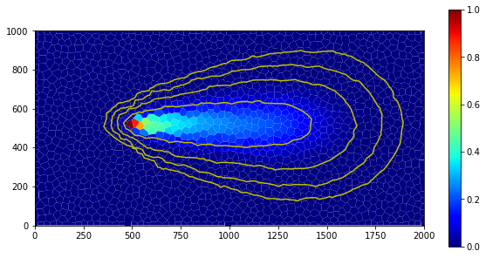



FloPy pre- and post-processing
Parallel MODFLOW Training Class, July 13-14, 2023, Lakewood, CO

Slide 2
FloPy Overview
FloPy is a Python package for creating, running, and post-processing MODFLOW-based groundwater flow and transport models. FloPy includes functionality to support MODFLOW 6 including support for unstructured grids.
MODFLOW support
MODFLOW 6
MODFLOW-2005
MODFLOW-NWT
MODFLOW-USG
MODFLOW-2000
Other model support
MODPATH (v. 6 and 7)
MT3DMS
MT3D-USGS
SEAWAT

Slide 3






















FloPy Family Tree
2010
2013-2015
+ 28 others
2016-2017
2018-2019
2020-2023

Slide 4
FloPy MODFLOW 6 Support

Slide 5
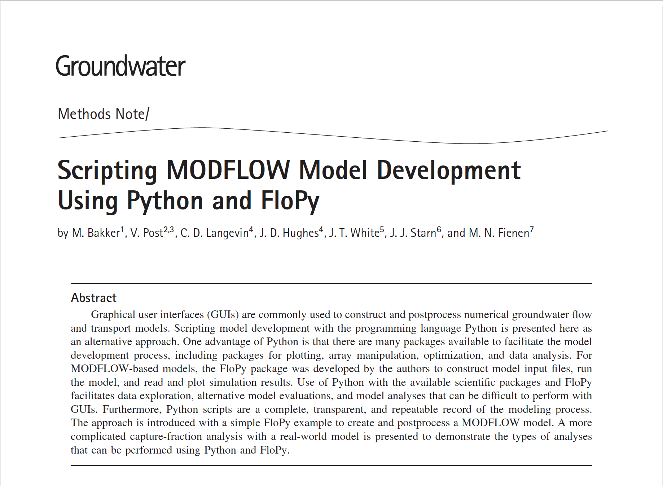
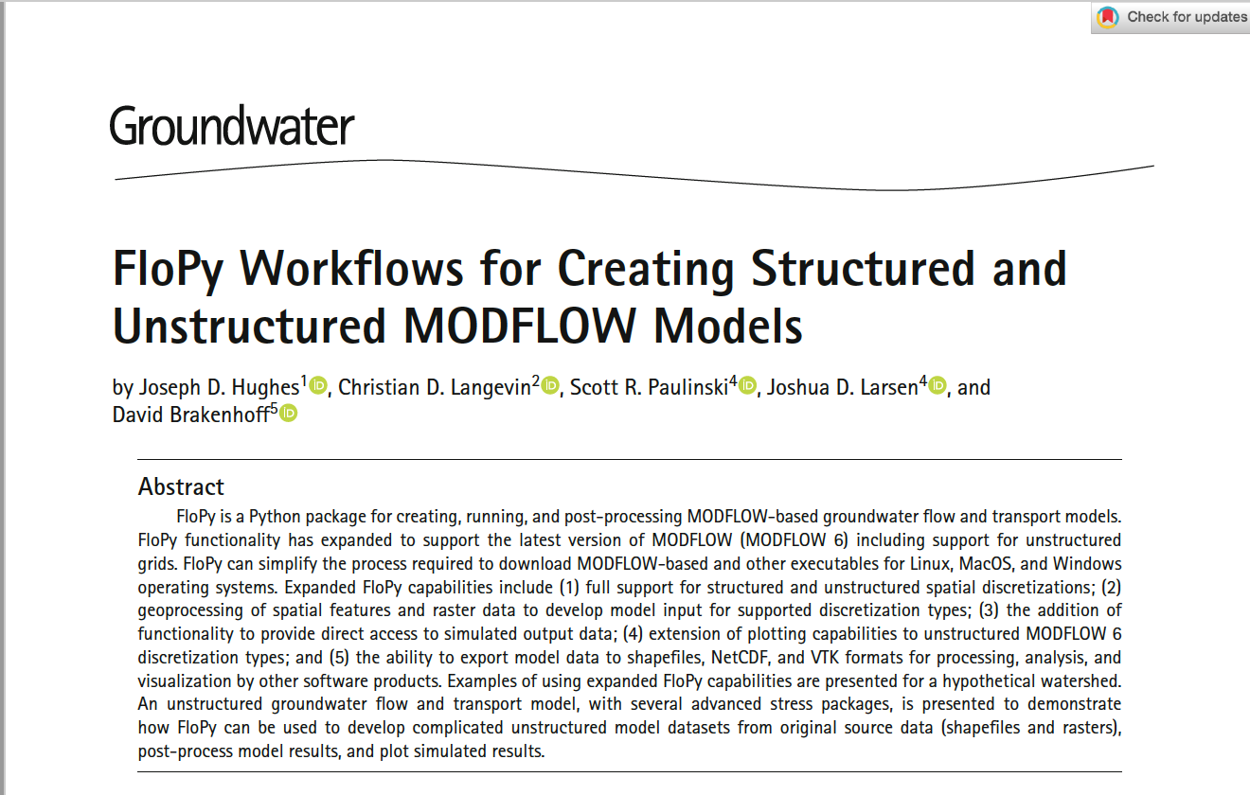
FloPy Publications
2016
https://doi.org/10.1111/gwat.12413
2023
https://doi.org/10.1111/gwat.13327

Slide 6
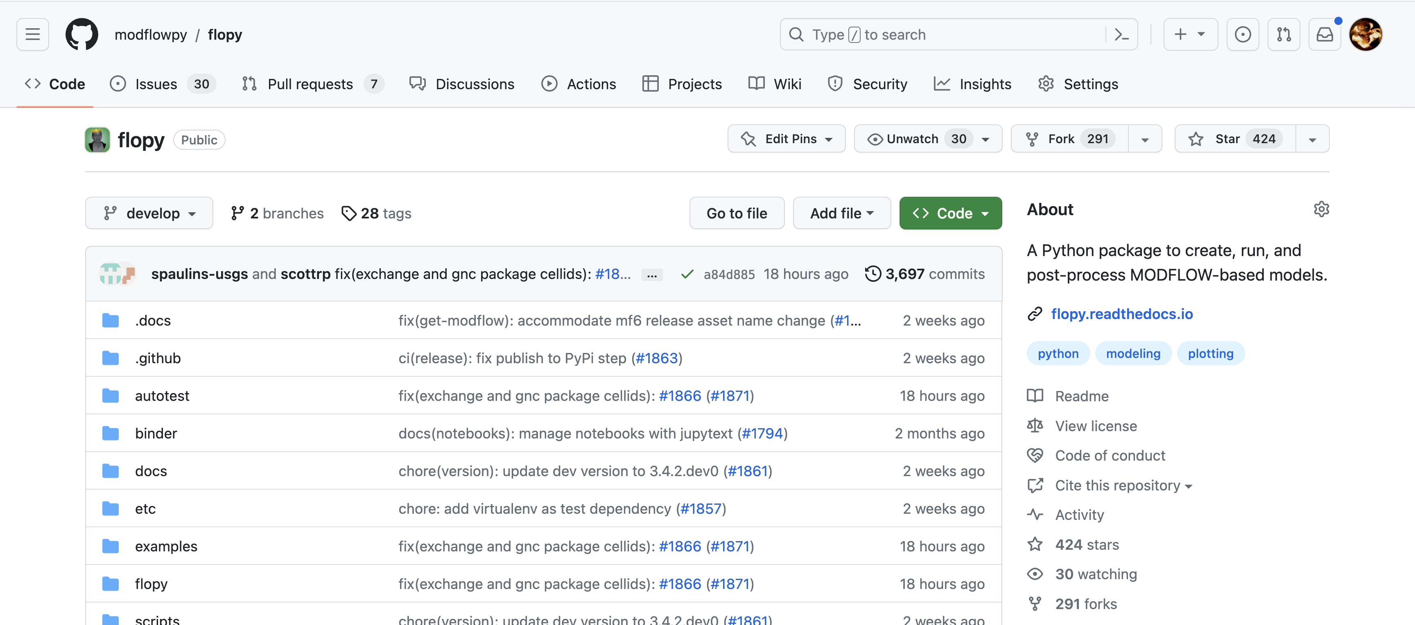
FloPy Resources
https://github.com/modflowpy/flopy

Slide 7
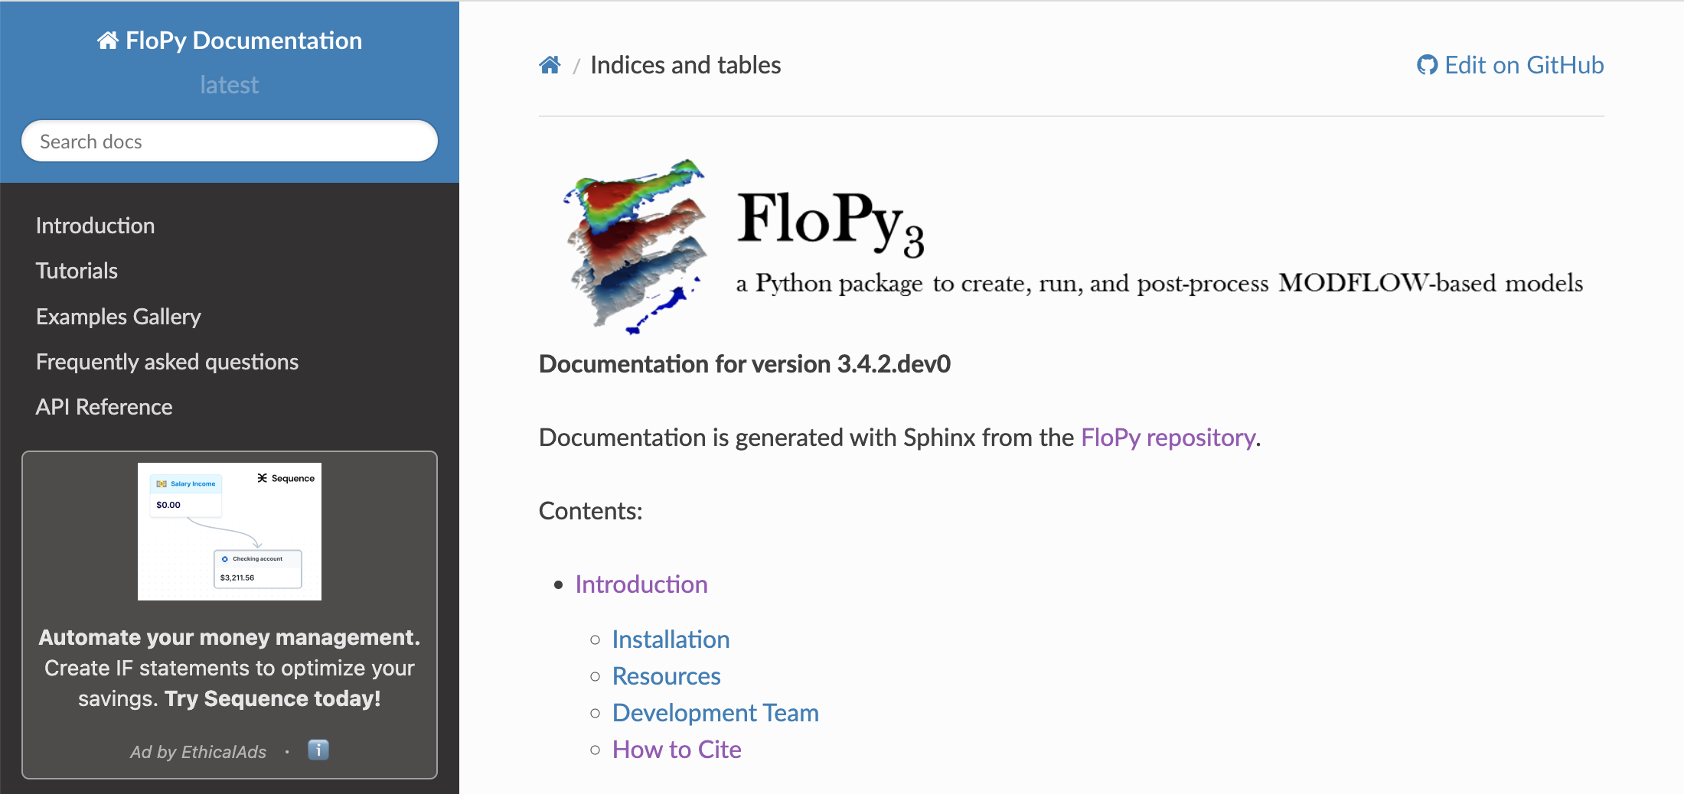
FloPy Resources
https://flopy.readthedocs.io/en/latest/index.html

Slide 8
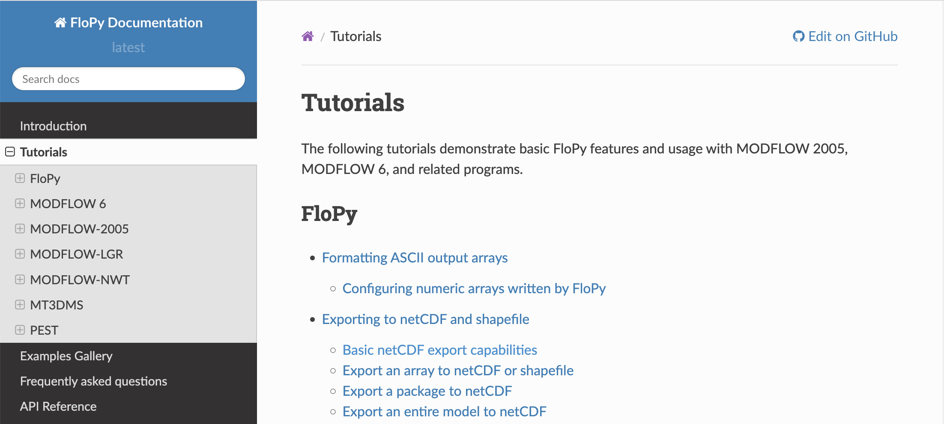
FloPy Resources
https://flopy.readthedocs.io/en/latest/tutorials.html

Slide 9
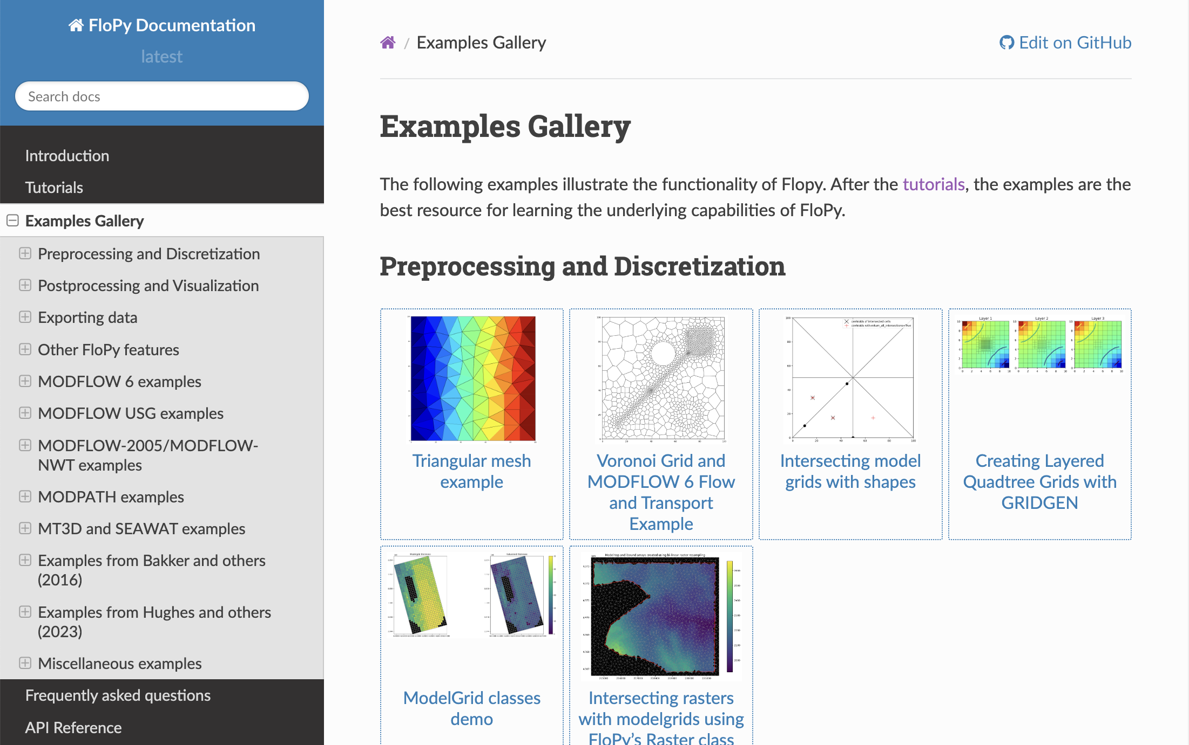
FloPy Resources
https://flopy.readthedocs.io/en/latest/examples.html

Slide 10
How to get FloPy
pip pip install flopy
conda / mamba conda install –c conda-forge flopy
GitHub (latest development version) pip install https://github.com/modflowpy/flopy/zipball/develop

Slide 11
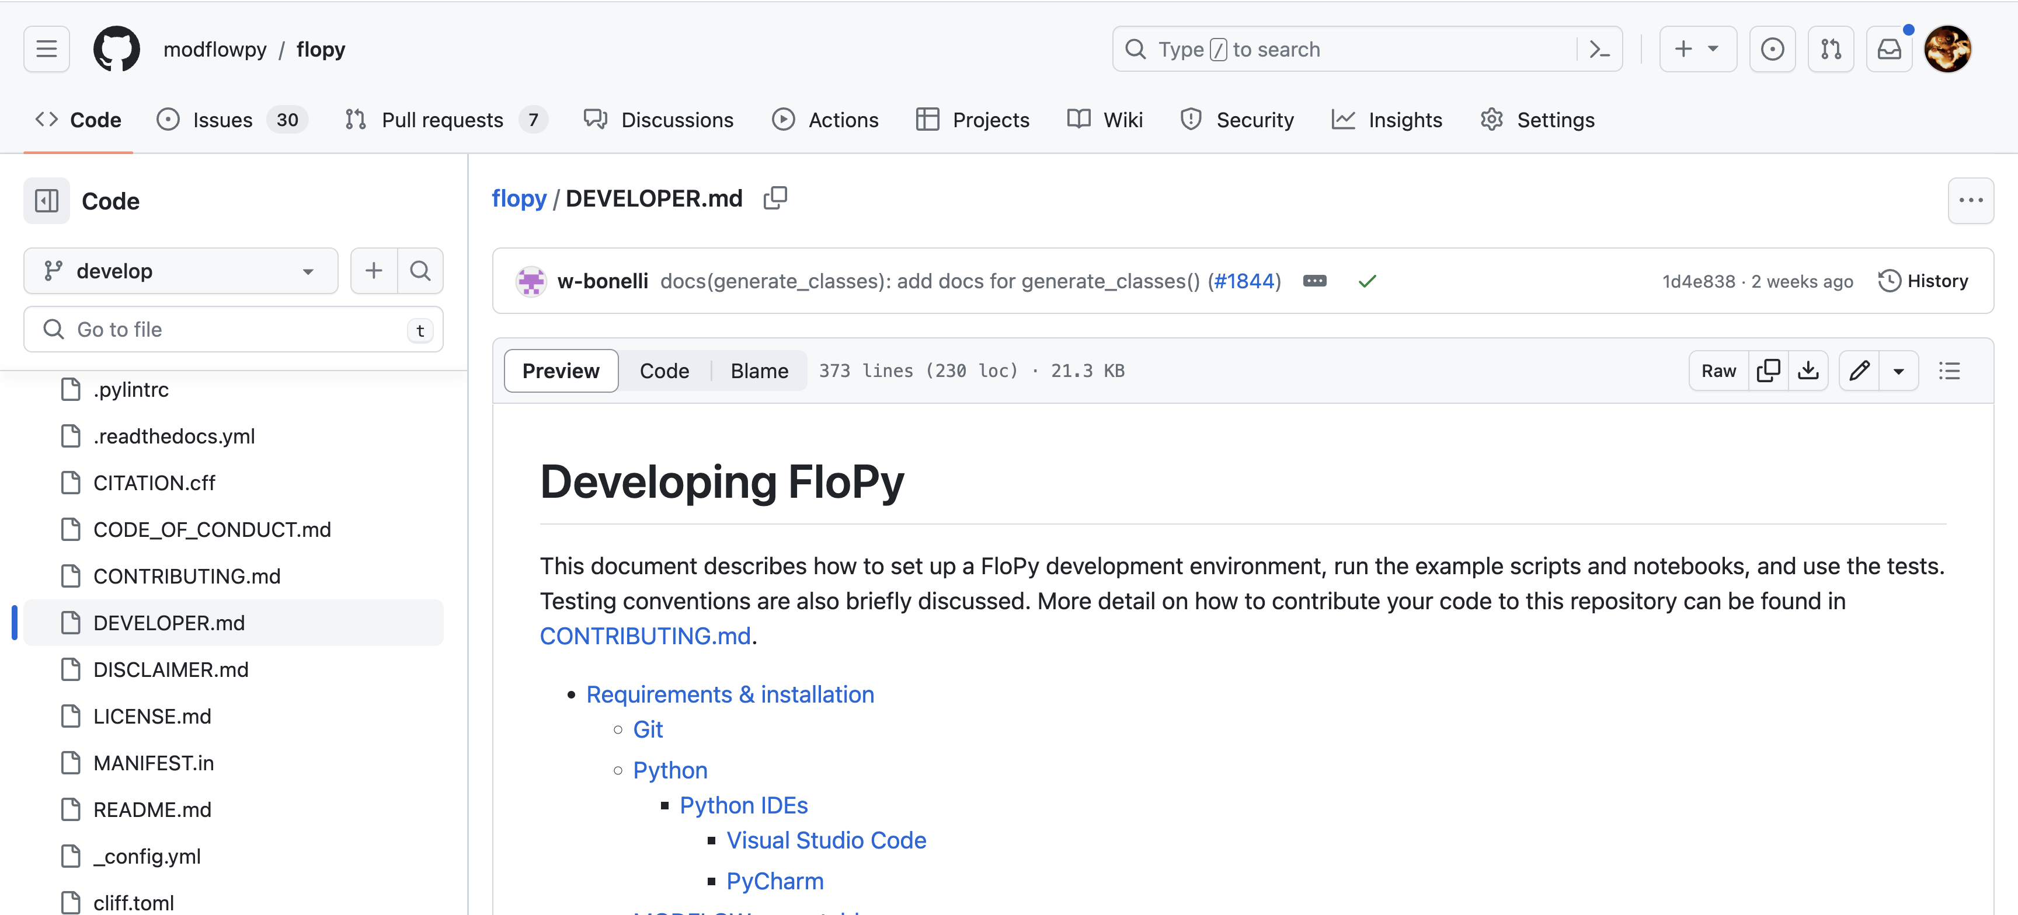
How to contribute
https://github.com/modflowpy/flopy/blob/develop/DEVELOPER.md

